Slide 1


Xception Model (Pretrained on ImageNet, First 20 Layers Frozen)
Exit Flow
Middle Flow (Repeat 8 Times)
Entry Flow
ReLU
ReLU
3×3 SCONV
3×3 SCONV
3×3 SCONV
3×3 CONV
3×3 CONV
ReLU
MaxPool
3×3 SCONV
3×3 SCONV
3×3 SCONV
ReLU
ReLU
ReLU
ReLU
MaxPool
ReLU
3×3 SCONV
Contrastive Model
3×3 SCONV
3×3 SCONV
ReLU
ReLU
ReLU
ReLU
MaxPool
….
….
ReLU
ReLU
MaxPool
3×3 SCONV
3×3 SCONV
3×3 SCONV
Input: 128×128×3
Global avg pooling
ReLU
1×1
CONV
1×1
CONV
1×1
CONV
$$128$$
$$unit$$
$$512$$
$$unit$$
1×1 CONV
3×3 SCONV
Transfer finetuned weight to the Segmentation model
output
Conv2d, act = relu
Conv2d, kernel_size=1
(None, 256, 256, 32)
Input: 256×256×3
(None, 256, 256, 1)
act=sigmoid
Concatenate
Concatenate
Conv2d, act = relu
CBAM
block1_conv2_act
Resize to target
(None, 256, 256, 32)
(None, 125, 125, 64)
Xception encoder-based segmentation model
block2_sepconv2_act
Conv2d, act = relu
(None, 125, 125, 128)
CBAM
Concatenate
Resize to target
(None, 128, 128, 64)
(None, 63, 63, 256)
block3_sepconv2_act
Conv2d, act = relu
CBAM
Concatenate
Resize to target
(None, 64, 64, 128)
Conv2d, act = relu
CBAM
block4_sepconv2_act
Resize to target
(None, 32, 32, 256)
(None, 32, 32, 728)
block13_sepconv2_act
(None, 16, 16, 512)

Slide 2
Final Segmented Mask
Conv2d, act = sigmoid
Input: 256×256×4
Concatenate
(None, 256, 256, 1)
Custom_conv_block
(None, 128, 128, 32)
Custom_conv_block
(None, 256, 256, 32)
Max_pool_2d
Concatenate
Max_pool_2d
Custom_conv_block
(None, 64, 64, 64)
Custom_conv_block
(None, 128, 128, 64)
Max_pool_2d
Concatenate
Max_pool_2d
Custom_conv_block
(None, 32, 32, 128)
Custom_conv_block
(None, 64, 64, 128)
Conv2d, act = relu, stride=5
Max_pool_2d
Concatenate
Max_pool_2d
Custom_conv_block
Dropout=0.1
Custom_conv_block
(None, 16, 16, 256)
Custom_conv_block
(None, 32, 32, 256)
Conv2d, act = relu
Max_pool_2d
Max_pool_2d
(None, 16, 16, 512)
Custom_conv_block

Slide 3
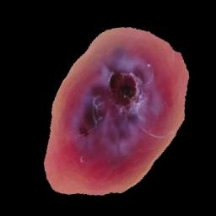


56×56×96
28×28×192
14×14×384
7×7×768
Stage 1
Stage 2
Stage 3
Stage 4
ConvNeXt Block
Apply CLAHE
Clip Limit = 2%
ConvNext Preprocessing
Input: 224×2224×3
Normalization
Downsample
Downsample
ConvNeXt
Block
Downsample
ConvNeXt
Block
ConvNeXt
Block
ConvNeXt
Block
Steam
DepthwiseConv2D
×3
×3
×27
×3
LayerNormalization
Dense
Softmax Layer
ReLU
GELU Activation
Dense
Classified Output
….
Dropout = 0.25
….
Dropout = 0.3
Global avg pooling
Coordinate Attention
Layer Scale
$n_{c}$ unit
DropPath
Segmented Image
$$128 unit$$
L1=1e-4, L2=1e-3
Fully Connected Layer

Slide 4
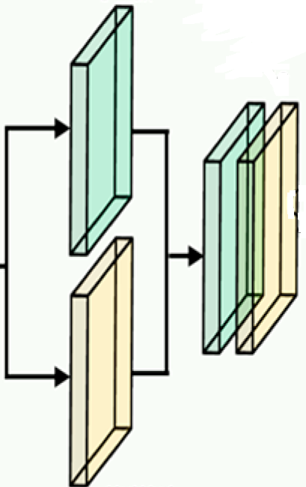
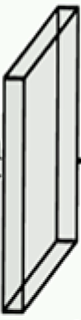
Max pooling
H×W×1
Feature: H×W×C
Global max pooling
C/16
C
Global max pooling
Feature: H×W×C
concat
H×W×2
H×W×1
1×1×C
conv
7×7
H×W×C
Global avg pooling
Global avg pooling
1×1×C
Shared Dense
Layer
Avg pooling H×W×1
Channel Attention Module
Element-wise Product
Spatial Attention Module
Element-wise Addition
Sigmoid Activation

Slide 5
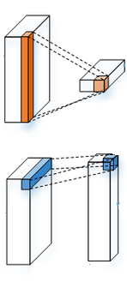
Avg pool
over height
1×1 conv
Act. = Sigmoid
Feature: H×W×C
H×1×C
(H+W)×1×C
H×1×C//32
H×1×C
H×W×C
1×W×C
(H+W)×1×C//32
split
W×1×C
BatchNorm.
1×W×C//32
1×W×C
Transpose
1×1 conv
Act. = ReLu
W×1×C//32
Transpose
1×1 conv
Act. = Sigmoid
Avg pool
over width
Element-wise Addition
Element-wise Product

Slide 6
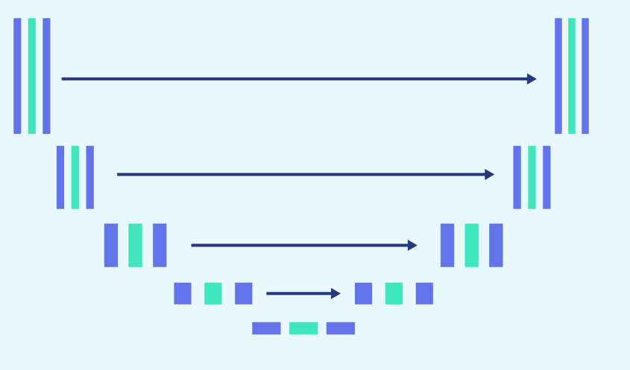
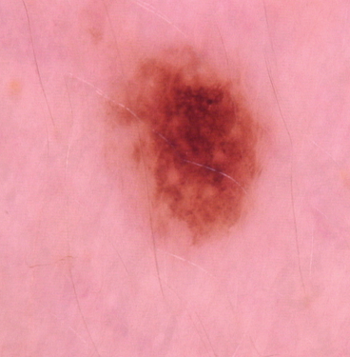
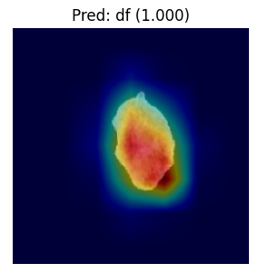
Stage 1
Three-Stage Attention-Enhanced Segmentation with Refiner
Stage 2
Stage 3
Pretrained
Xception
CNN Model
Fine Tuned
To Predict
Pixel Masks
Xception
Encoder
→
CBAM
Based Decoder
Segmented
output
U-Net Based
Refiner
(~7M Parameter)
Segmented
Final output
Input Data
Weight Transfer
ConvNextSmall
Classifier with
Coordinate Attention
Segmented
Dataset
ISIC 2017,
ISIC 2018,
HAM10000,
MILK10K
GradCam++ heatmap
With confidence score
Apply CLAHE for leisson Enhancement
Comprehensive Image Augmentation (flip, rotate, scale, crop, color & noise variations) for Class Balance
Classified Output
Segmentation Model Result:
Classification Model Result:
Training Dataset: ISIC 2018 (with 10% hold-out test set) — Dice = 90.28, IoU = 84.18, Accuracy = 95.60%, 95% CI (Dice) = 88.87–91.52.
Robustness Evaluation: Tested on ISIC 2017 (100% hold-out test set) — Dice = 91.57, IoU = 85.15, Accuracy = 97.07%, 95% CI (Dice) = 91.24–91.87.
HAM10000 (10% hold-out test set): Accuracy = 98.15%, F1-score = 98.15%, AUC = 99.91%, 95% CI (Accuracy) = 97.79–98.55%.
MILK10K (10% hold-out test set): Accuracy = 87.03%, F1-score = 86.82%, AUC = 97.78%, 95% CI (Accuracy) = 85.40–88.60%.
(Note: Classification datasets were first segmented using the proposed segmentation model.)

